Slide 1

European Data Management Workshop
Victor Turpin – OceanOPS – vturpin@ocean-ops.org
20th June 2022
Status of the European Real Time glider data management system in the international context

Slide 2
Agenda
Global and European glider activity
How are we monitoring the activity ?
How are we monitoring the data flow ?
The status of the European data flow ?

Slide 3
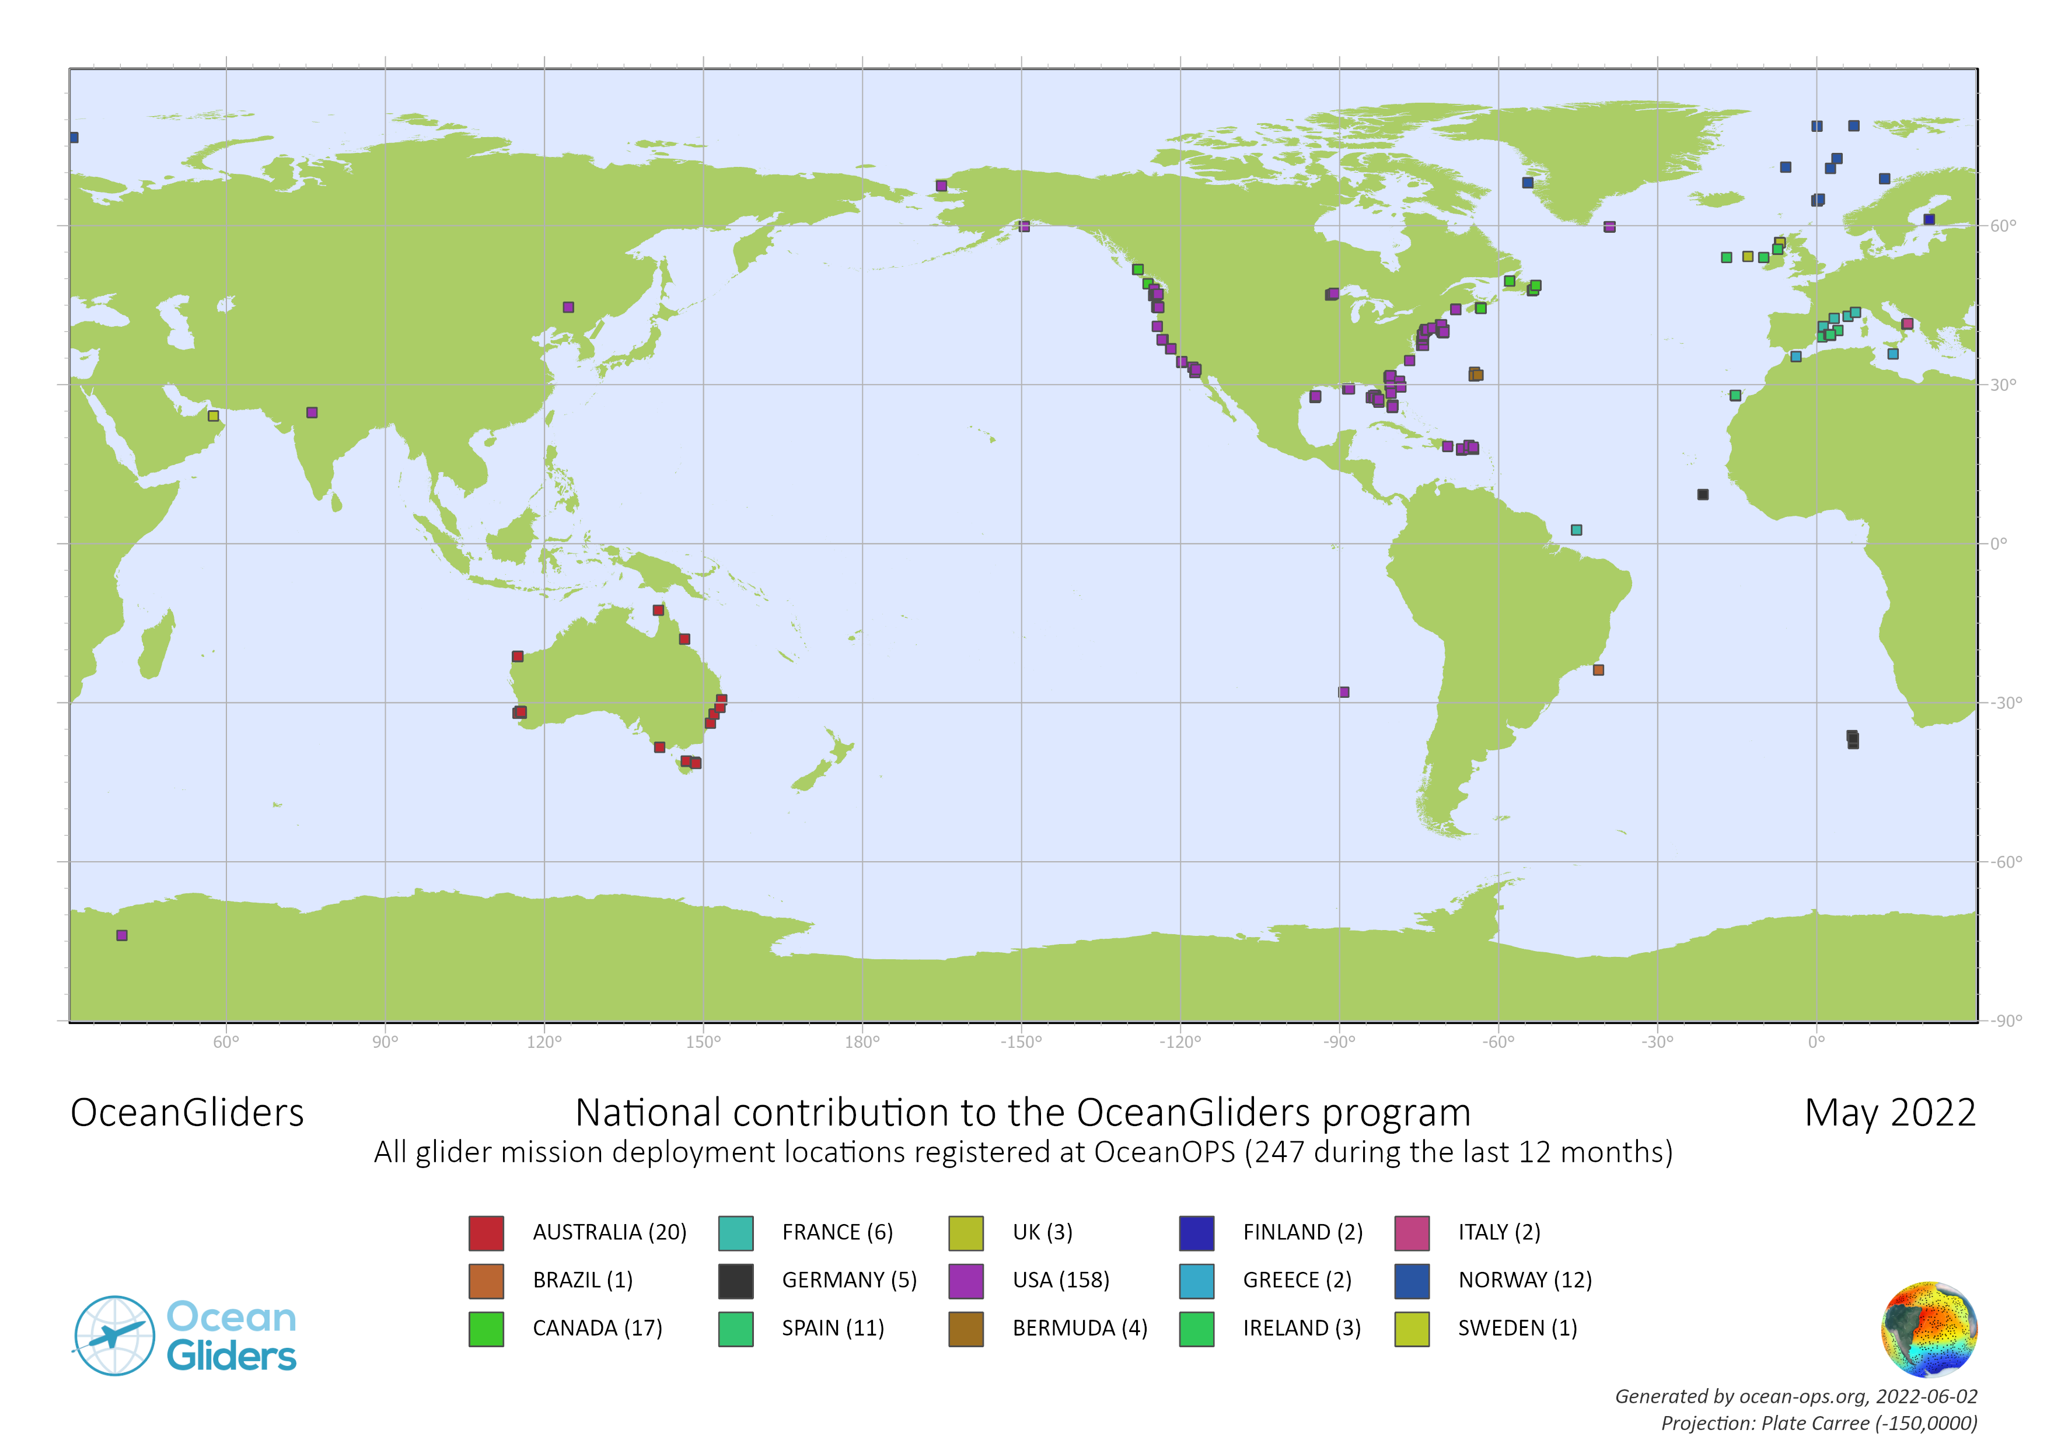
Global and European glider activity

Slide 4
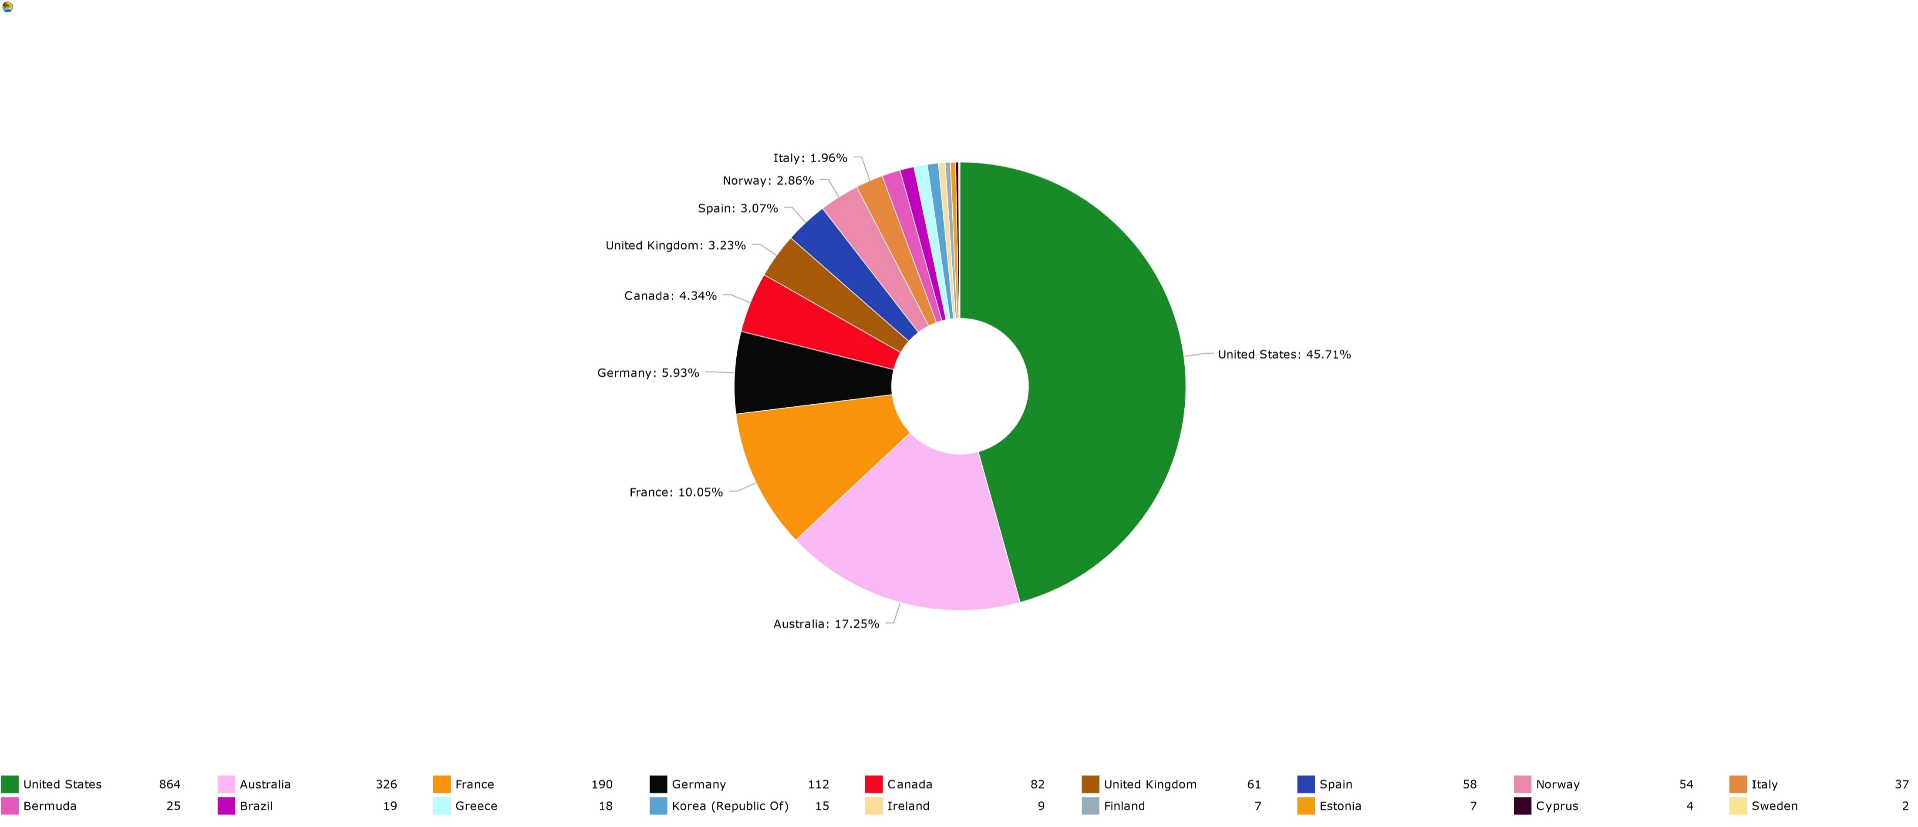

Global glider activity
EU represents 42% of the historical contribution to the OceanGliders program (in terms of deployments registered so far in OceanOPS)
Australia = 17% (complet), US* = 48% (incomplet - 1/3 is missing), Canada = 5% (incomplete), Korea+Brazil = 2% (incomplete)
Global activity is growing making it difficult to monitor without a common approach in terms of data management.

Slide 5
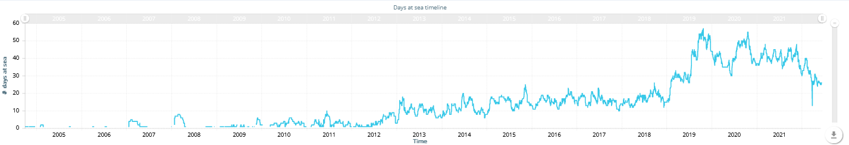
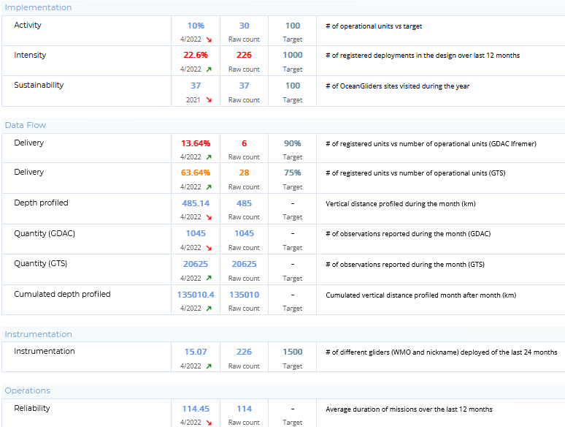
Global glider activity
Decrease in the cumulated number of days at sea not due to a limitation of the activity or performance but the difficulty to monitor properly the OceanGliders program.
KPIs (Beta version) computed automatically but not relevant enough without a complete monitoring
Tools exist for the global but can be addapted to the regional.

Slide 6
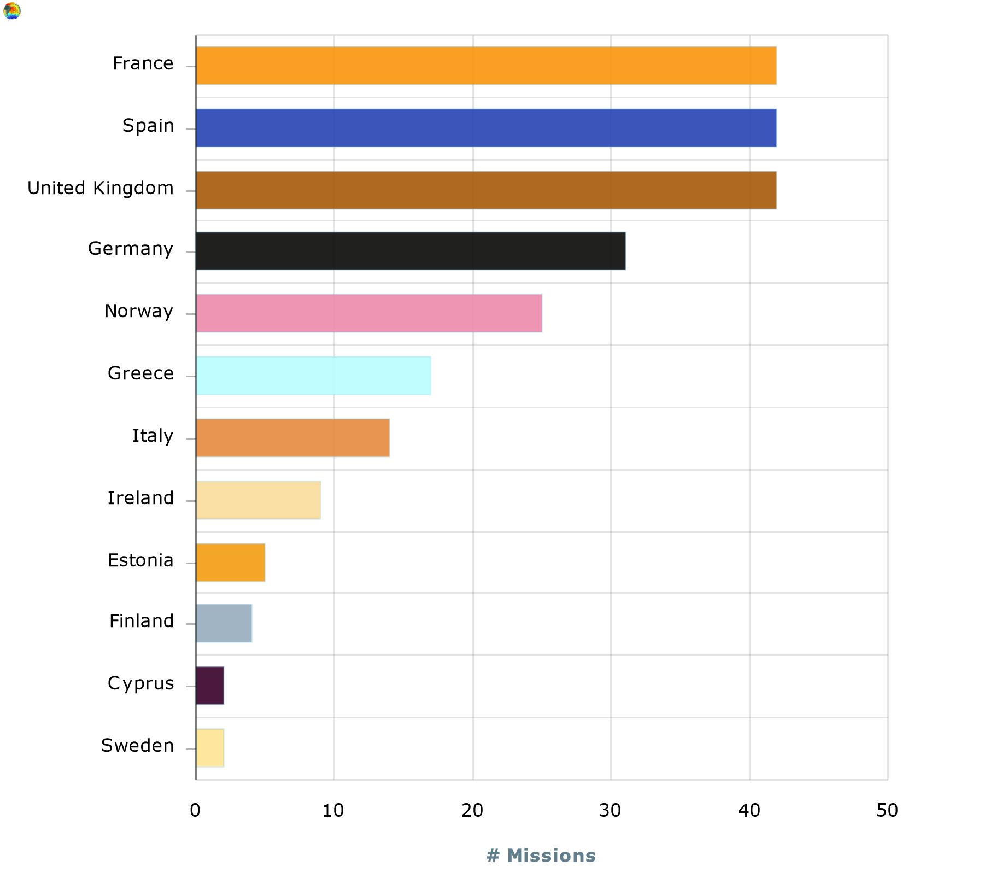
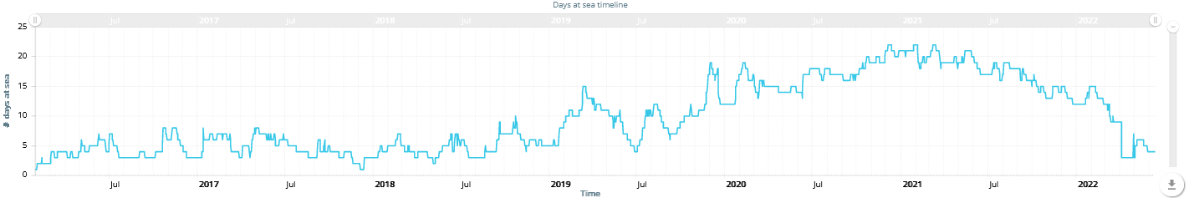
European glider activity (since 2018)
Does this bar chart reflect the real European glider activity?
Is the decrease in the number cumulated days at sea real ?
Need for a better monitoring of the glider activity in Europe.
Need for an improved glider data and metadata management in Europe.

Slide 7
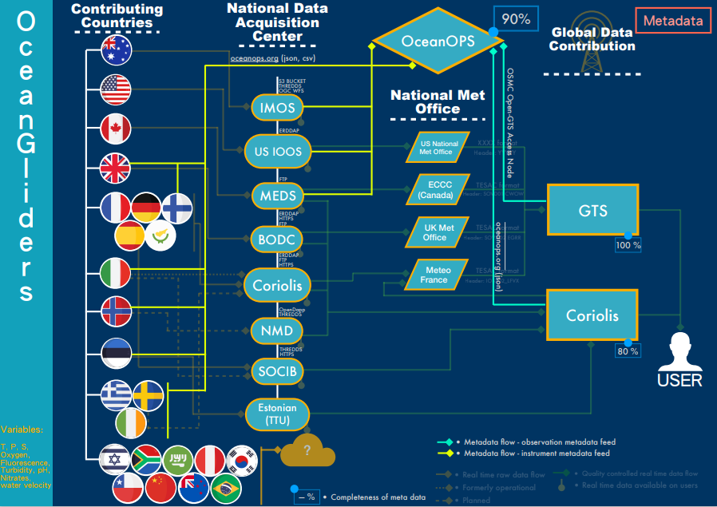
II. How are we monitoring the activity?

Slide 8

How are we monitoring the activity?
Metadata harvesting
Manual (from glider groups website to online form)
Semi-automated processing (json, csv files, from GTS)
Time consuming
Source of errors and oversight
How can we improve?
Centralize the European glider data and metadata
Simplify PIs and Operators life (one entry point for data and metadata distribution)
Harmonizing the standard, format, vocabularies
To automatise the procedures and fit data and metadata users requirements

Slide 9
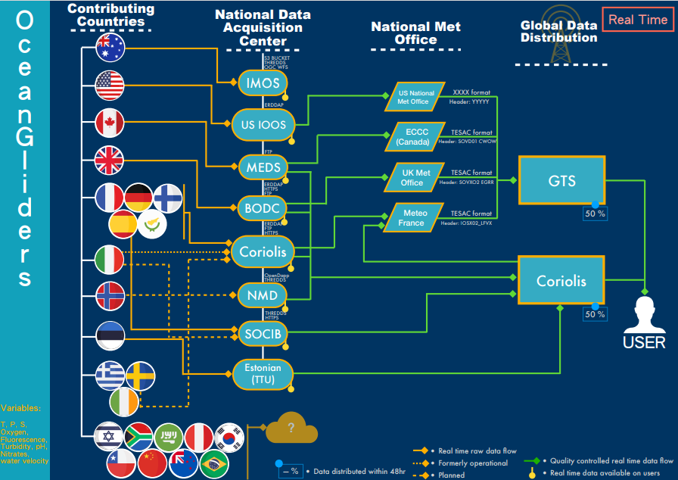
III. How are we monitoring the data flow?

Slide 10
III. How are we monitoring the data flow?

Slide 11
How do we monitor the data flow?
From GTS
Matching registered WMO ID (glider unique ID) with pre-filtered GTS data.
Need to now the data providers (National Met offices)
Need the header of each data provider on GTS
Need registration of the glider mission at OceanOPS
High complexity
From “GDACs”
Only from Coriolis at the moment (not IOOS Glider DAC nor IMOS AODN)
Centralize GDAC would be very helpful for monitoring data flow
Through index file parsing (profile index file and trajectory index file)
Simple, robust, flexible (index file can be modified on request – e.g. max depth)
How can we improve?
Simplify the data flow toward European GDAC (Coriolis)
Validate BUFR format for Gliders on GTS
Rely on multiple DAC to produce common format
Centralize OceanGliders data sets into on place

Slide 12
IV. The status of the EU data flow?

Slide 13
Status of the EU data flow
75% of the glider data set (deployments registered in the OceanOPS system) is available at DACs.
Still difficult to track EU gliders data on GTS
75% is a good score considering the diversity of DAC and operators in Europe
But the trend should warn us :
While activity is growing, data availability is decreasing.
Results biased by the historical glider deployments only available in DACs repositories.
Correlation between increasing activity, increasing number of glider groups in EU and decrease in data availability at DACs and GDACs

Slide 14
Structural improvement in the EU glider data management needed
Toward a uniformization of the glider data management globally
From 3 widely used format to OG1.0 (https://github.com/OceanGlidersCommunity/OG-format-user-manual)
A flexible philosophy : common baseline, standard and format, but extendable.
Common vocabularies
Common data flow (GDAC and GTS) for “standard” variables (T, S, O2, Chla, CDOM, BBP)
Common Quality Control ?
Improve efficiency of the EU glider data management scheme – this meeting
Improve data flow on the short term (week 1)
Re-think the current data management scheme in Europe (week 2 – ws 1)
Always avoid duplication effort for Operators and Pis to reach data and metadata services

